Slide 1
Agentic Portal: A Unified AI Agent Gateway & Orchestration MVP

Slide 2
Agenda
Project Requirements Overviews
Project Scope
3) Core Architecture: Intelligent Routing & MCP Aggregation Gateway
4) Milestones & Acceptance Criteria
5) Future Evolution Plan

Slide 3
Project Requirements Overviews (4 perspectives)
Unified Interaction & Experience
Single-Entry Portal Architecture
Establish a centralized Web portal to eliminate the friction of switching between multiple AI applications and chatbots.
Natural Language Intent Interaction
Support fully intent-driven inputs, enabling users to invoke diverse AI capabilities without memorizing specific commands.
2. Intelligent Routing & Memory Engine
Dynamic Intent Routing
Autonomously dispatch queries between MCP tools, vertical bots, and general LLMs based on real-time intent analysis.
Session Context Persistence (MVP Core)
Maintain session-level memory to support pronoun resolution and automated parameter completion in multi-turn dialogues.
Automated Entity Extraction
Identify and extract key entities from conversations to automatically populate tool execution schemas.

Slide 4
Project Requirements Overviews (4 perspectives)
3. Standardized Integration & Extensibility
Standardized MCP Integration
Leverage Model Context Protocol (MCP) as the core standard to achieve "plug-and-play" tool integration via an aggregated gateway.
Heterogeneous System Compatibility
Integrate existing vertical chatbots via standard APIs to protect legacy IT investments.
Metadata-Driven Configuration
Enable agent onboarding via metadata updates, eliminating the need to modify the portal’s core codebase.
4. Security, Monitoring & Governance
Granular Access Control
Implement Role-Based Access Control (RBAC) to provide agent-level auditing and protection for sensitive tools and data.
Full-Chain Execution Monitoring
Track the entire lifecycle from intent routing to tool execution for performance monitoring and troubleshooting.

Slide 5
Project Scope
The core goal is to establish :
A unified conversational entry point that can identify user intent through intelligent routing, invoke different AI capabilities via the MCP aggregation gateway, or call upon third-party chatbots through standard APIs.
32 user stories
Technical Feasibility
MVP Core Path
10 user stories(MVP)

Slide 6
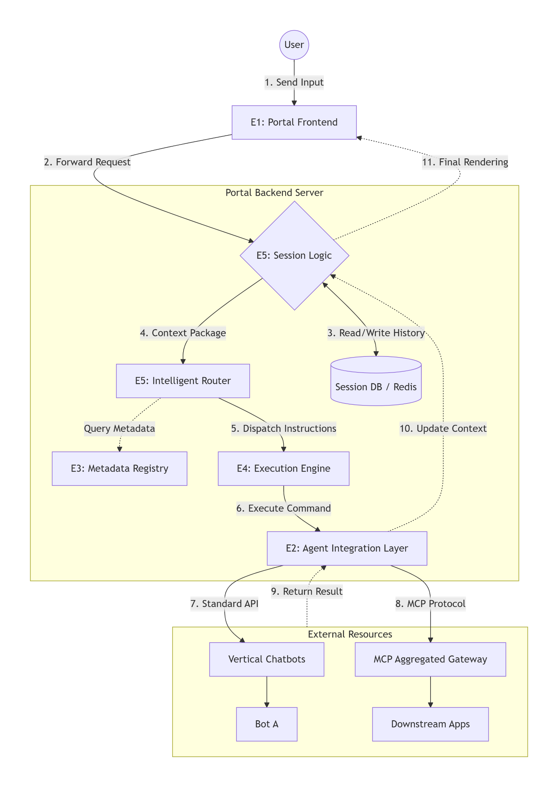
Core Architecture: Intelligent Routing & MCP Aggregation Gateway
E1: Portal Frontend
Provides a unified conversational interface for natural language input
E2: Agent Integration Layer Acts as a protocol bridge to adapt MCP and standard APIs, enabling seamless integration and metadata normalization for heterogeneous agents
E3: Agent Discovery & Overview Maintains a centralized registry of agent semantic descriptions and parameter schemas to support dynamic capability discovery by the LLM.
E4: Agent Execution Manages task lifecycles, including concurrent dispatching, timeout control, and error handling to ensure stable and efficient execution.
E5: Intelligent Routing & Session Logic Analyzes user intent using LLMs and integrates session history for context-aware routing and automated fallback to general LLMs.

Slide 7
Milestones & Acceptance Criteria
M1: Foundation & Protocol Prototyping (Weeks 1-5)
Core Objective: Establish backend infrastructure and ensure connectivity with external tools.
1.1 Session Storage AC: Implement Session-ID indexed storage in Redis/SQLite; ensure full message history is persistent and retrievable.
1.2 MCP Gateway Integration AC: Establish stable connection with MCP Aggregated Gateway; successfully retrieve downstream tool metadata
1.3 Capability Registry AC: Consolidate MCP tools and standard API bots into a unified registry for dynamic discovery.

Slide 8
Milestones & Acceptance Criteria
M2: Core Intelligence: Routing & Context (Weeks 6-10)
Core Objective: Implement intent recognition and context-aware multi-turn conversation.
2.1 Contextual Memory Injection AC: Automatically retrieve the latest N-turn history and inject it into the LLM prompt for context awareness.
2.2 Intent Routing & Fallback AC: Router correctly dispatches tasks to MCP tools, API bots, or general LLM based on user intent.
2.3 Reference resolution AC: Resolve pronouns (e.g., "it", "him") and extract missing parameters from session history.

Slide 9
Milestones & Acceptance Criteria
M3: Execution Engine & Hybrid Integration (Weeks 11-13)
Core Objective: Orchestrate external calls across heterogeneous protocols (MCP & API).
3.1 Task Execution (MCP & API) AC: Execute `call_tool` via MCP and handle standard HTTP requests for vertical domain bots.
3.2 Data Normalization AC: Transform diverse responses (JSON/Text) into a unified message object (Text/Table/Status).
3.3 Memory Write-back AC: Automatically update Session DB with execution results to maintain continuous context.

Slide 10
Milestones & Acceptance Criteria
M4: Portal Interface & E2E Validation (Weeks 14-16)
Core Objective: Deliver a seamless UI and ensure end-to-end system reliability.
4.1 Conversational Chat UI
AC: Deploy a clean UI with clear source labeling (e.g., "From: Finance Bot").
4.2 Real-time Feedback AC: Display active "Calling [Agent]..." status indicators during external execution.
4.3 E2E Integrity & Error Handling AC: Complete "Input-Route-Execute-Respond" loop with graceful handling of timeouts and API errors.

Slide 11
Future Evolution Plan
1. System Observability & Usage Analytics
Full-Chain Execution Logging
Log all user queries and tool execution chains for real-time performance monitoring and rapid troubleshooting.
Product Adoption Analytics
Track usage metrics across different agents to measure user adoption and evaluate the business impact.
2. Developer Enablement & Standardization
Standardized Onboarding Framework
Establish mandatory API architecture checklists and MCP description guidelines for seamless technical integration.
Automated Configuration Validation
Implement JSON Schema validation for MCP entries to catch configuration errors before deployment.

Slide 12
Thanks !

